Slide 1
WELCOME

Slide 2
PROPERTY MANAGEMENT APPLICATION USING SALES FORCE
TEAM MEMBERS
Nandhini R
Narmadha MK
Parinithaa T
Priyadharshini D

Slide 3
INDRODUTION:
Overview
Salesforce property management enables the realty managers to keep track of crucial data about financial & household properties incorporating associated cash flow, primary tenants, and occupancy rates.
Since there is no off-the-shelf solution offered directly by Salesforce for property management, you have three options:
Customize core Salesforce Clouds,
Buy a pre-configured solution from Salesforce partners,
Develop a custom app on the Force.com platform.

Slide 4
PURPOSE:
Property management application using salesforces is usually work for the owners of investment properties such as apartment and condominium complexes, private home communities, shopping centers, and industrial parks.
Their main roles are to manage routine tasks delegated to them by the owners and to preserve the value of the properties that they manage while generating income.

Slide 5
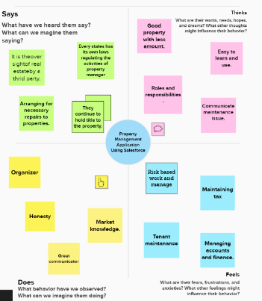
EMPATHY MAP

Slide 6
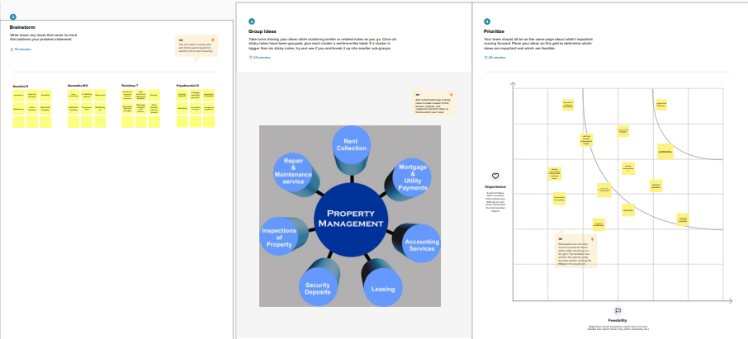
IDEATION & BRAINSTORMING MAP

Slide 7
DATA MODEL
Object Name | Fields in the Object
Object 1
Object 2
Object 3
Field Label | Data Type
Buy | Percentage
Field Label | Data Type
Rent | Text
Field Label | Data Type
Loan | Number

Slide 8
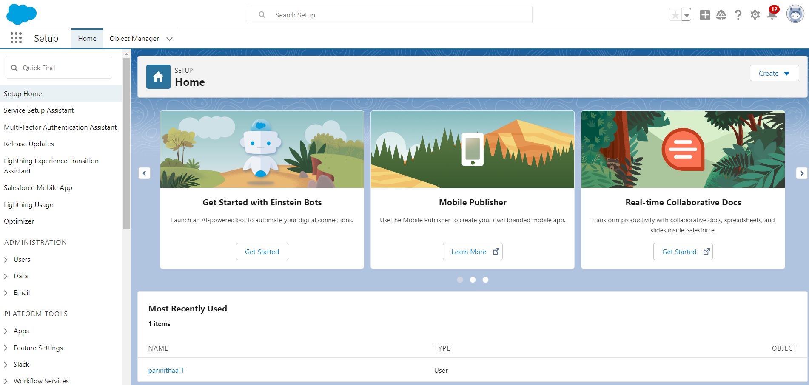
MILESTONE:1
Activity1: Creating Developer Account

Slide 9
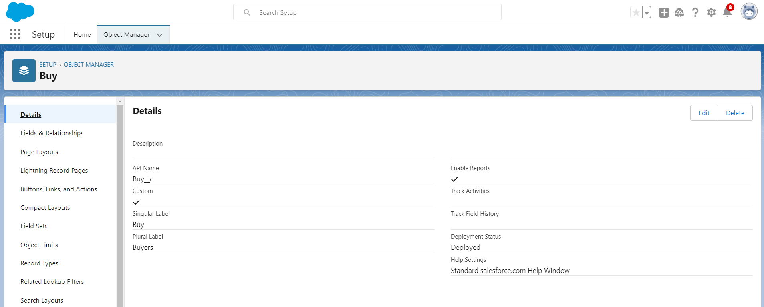
MILESTONE -2: Object Salesforce objects are database tables that permit you to store data that is specific to an organization. Activity 1: Create an object

Slide 10
Activity 2: Create Object buy

Slide 11
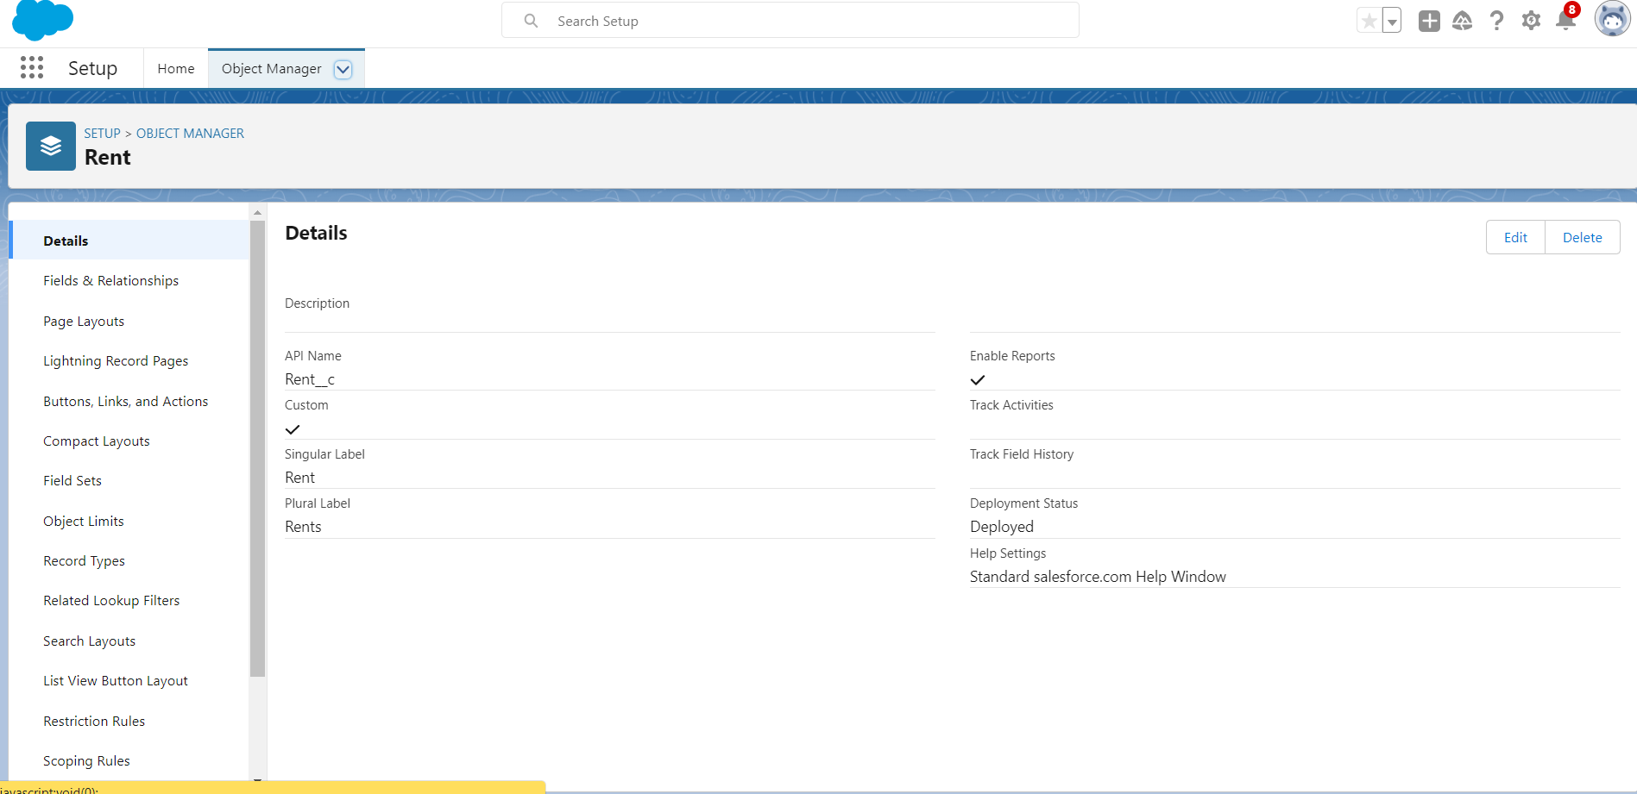
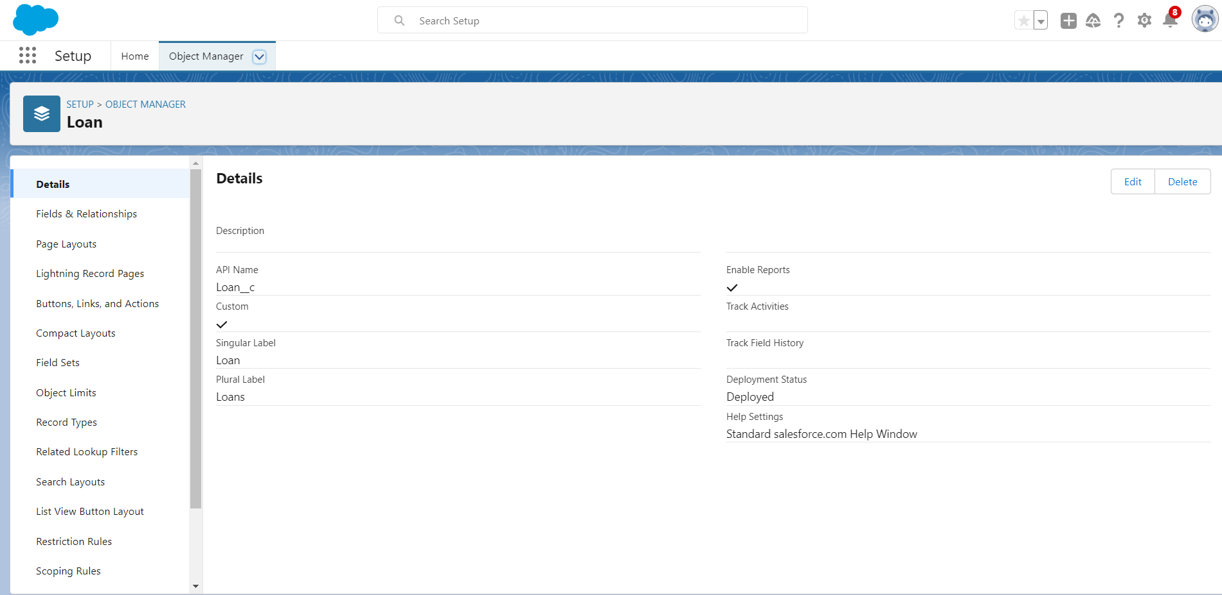
Activity 3: Create Object Rent Create Object Loan

Slide 12
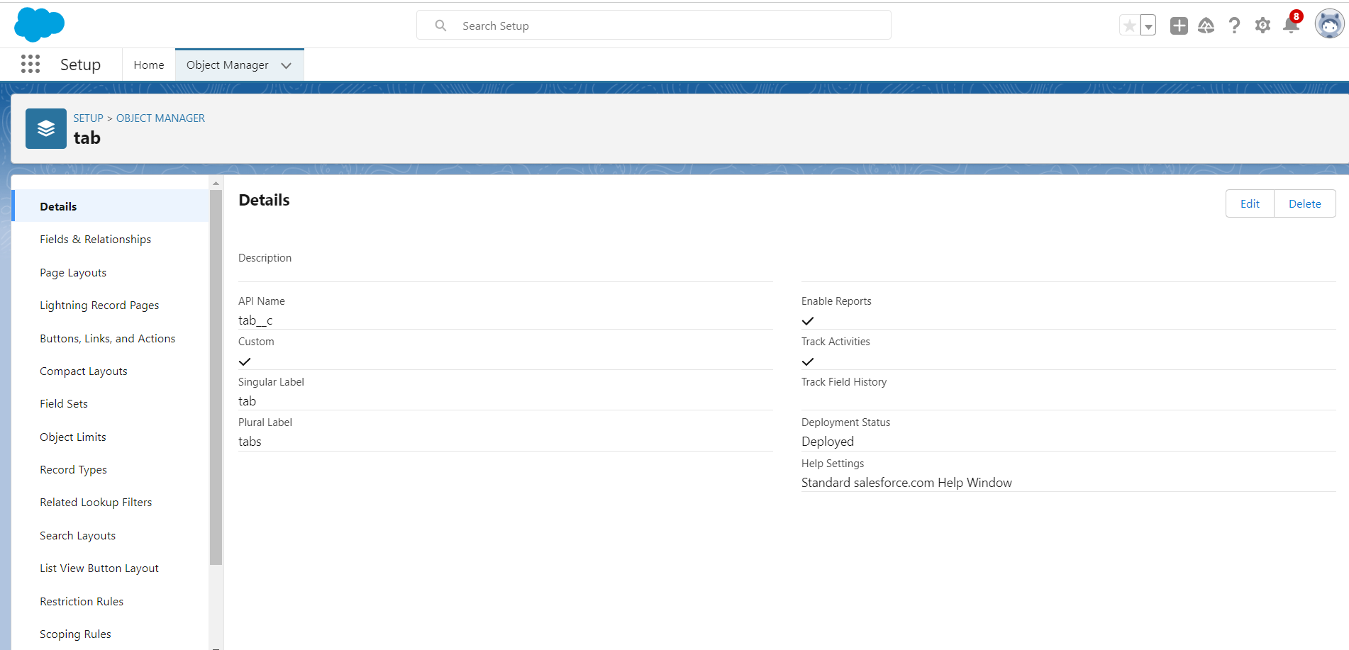
MILESTONE 3: Tab Activity 1: Create Lightning Tab
A tab is like a user interface that is used to build records for objects and to view the records in the object.

Slide 13
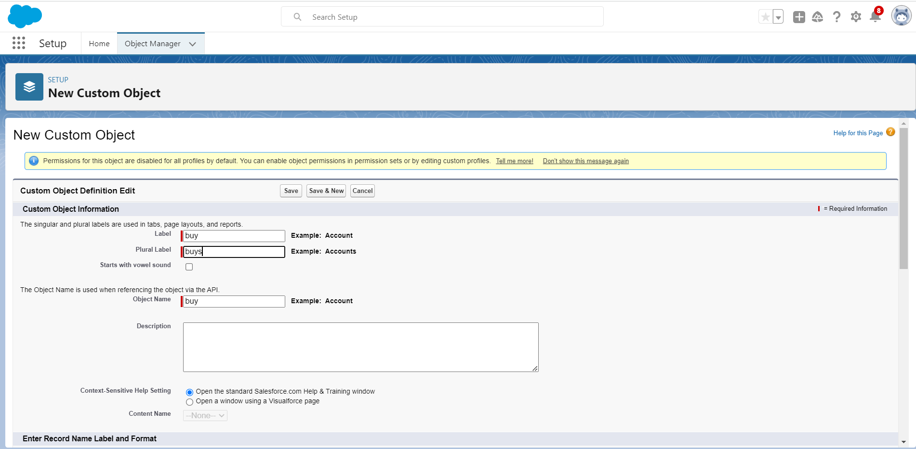
Activity 2: To create a Tab:(Buy)

Slide 14
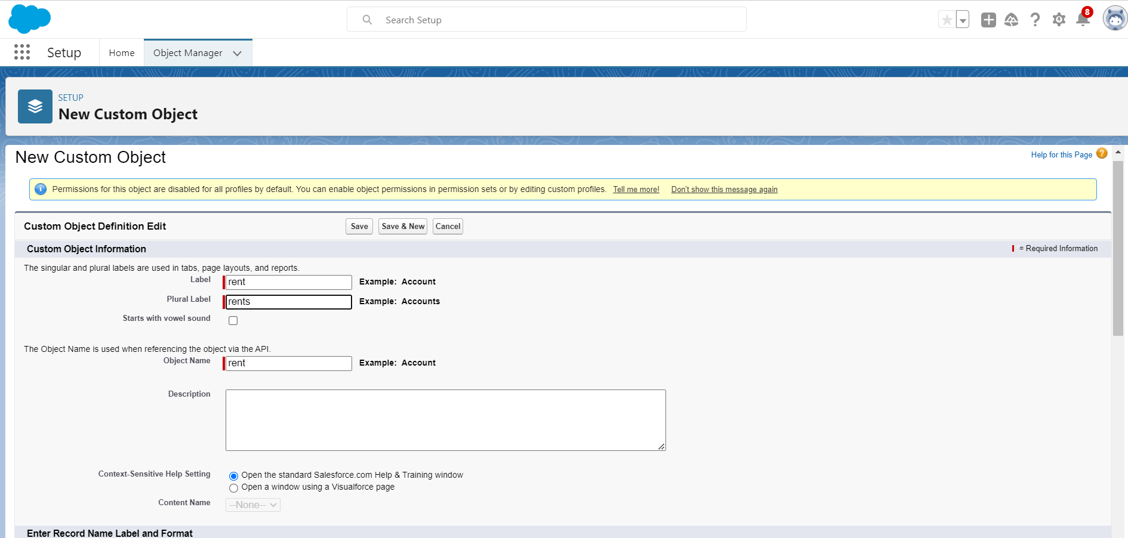
Activity 3: To create a Tab:(Rent)

Slide 15
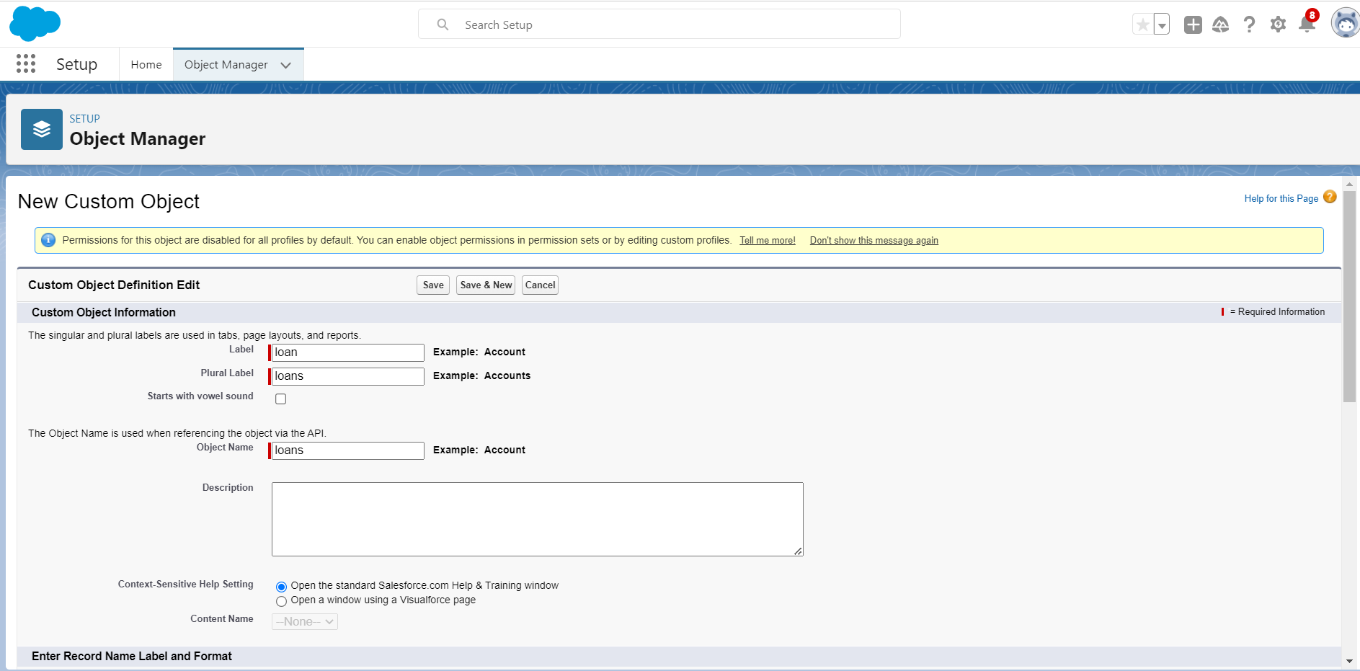
Activity 4: To create a Tab:(Loan)

Slide 16
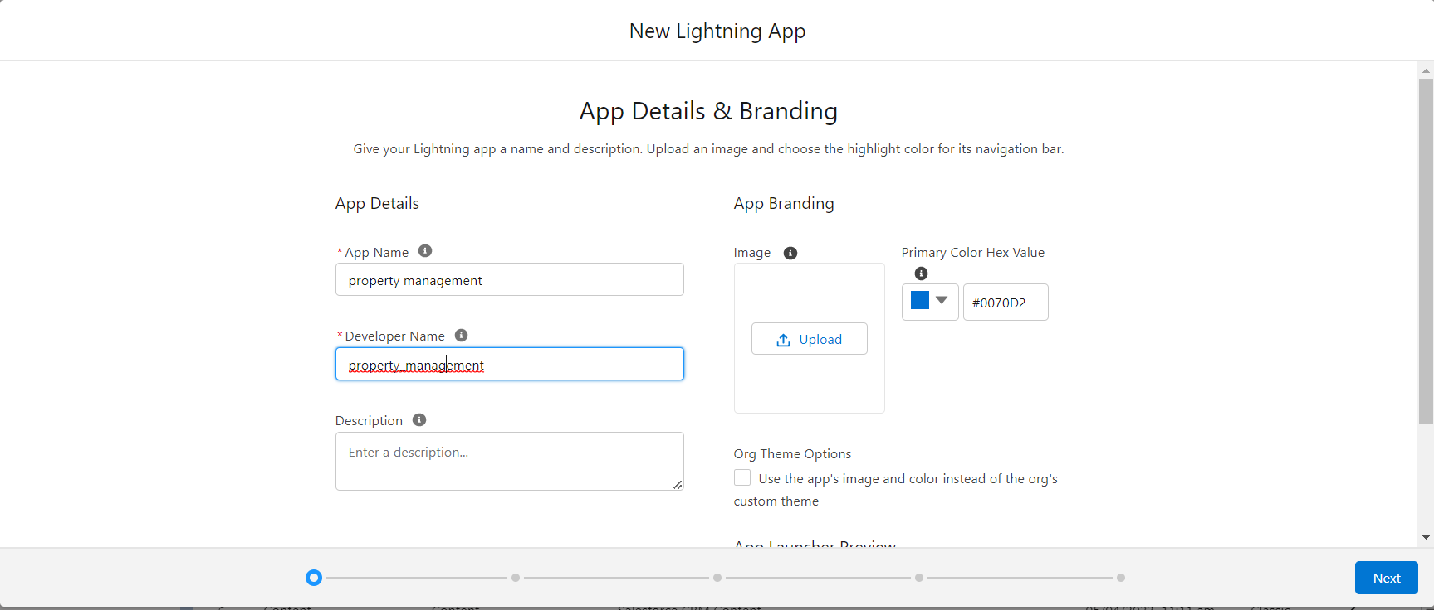
MILESTONE - 4: The Lightning App An app is a collection of items that work together to serve a particular function. In Lightning Experience, Lightning apps give your users access to sets of objects, tabs, and other items all in one convenient bundle in the navigation bar.
Activity1: Create the Lightning App

Slide 17
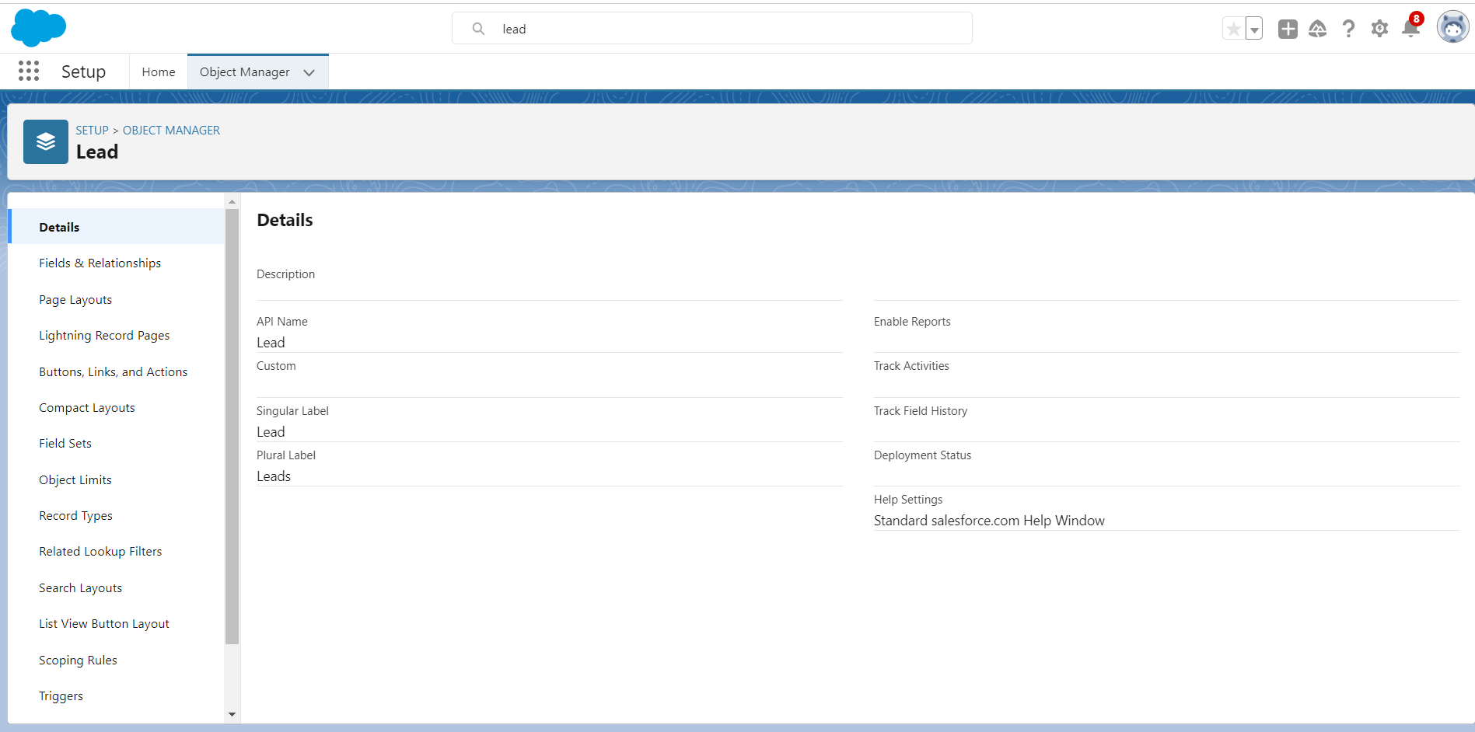
Milestone-5: Fields When we talk about Salesforce, Fields represent the data stored in the columns of a relational database. It can also hold any valuable information that you require for a specific object. Hence,the overall searching, deletion, and editing of the records become simpler and quicker.
Activity 1: Create the Lead Field

Slide 18
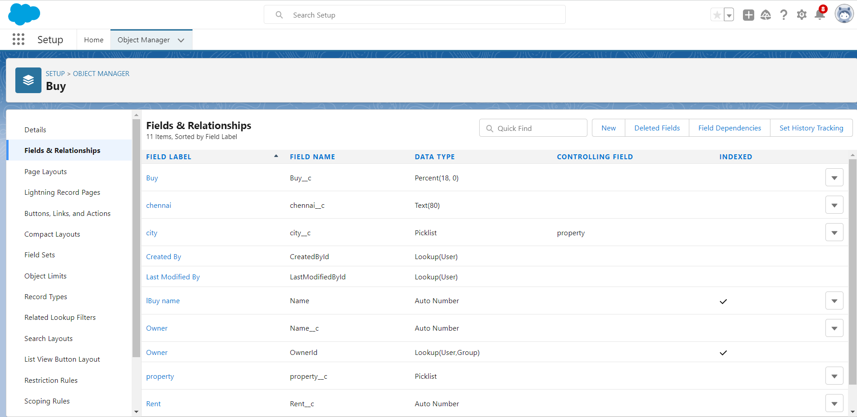
Activity 2: Create Field for Buy

Slide 19
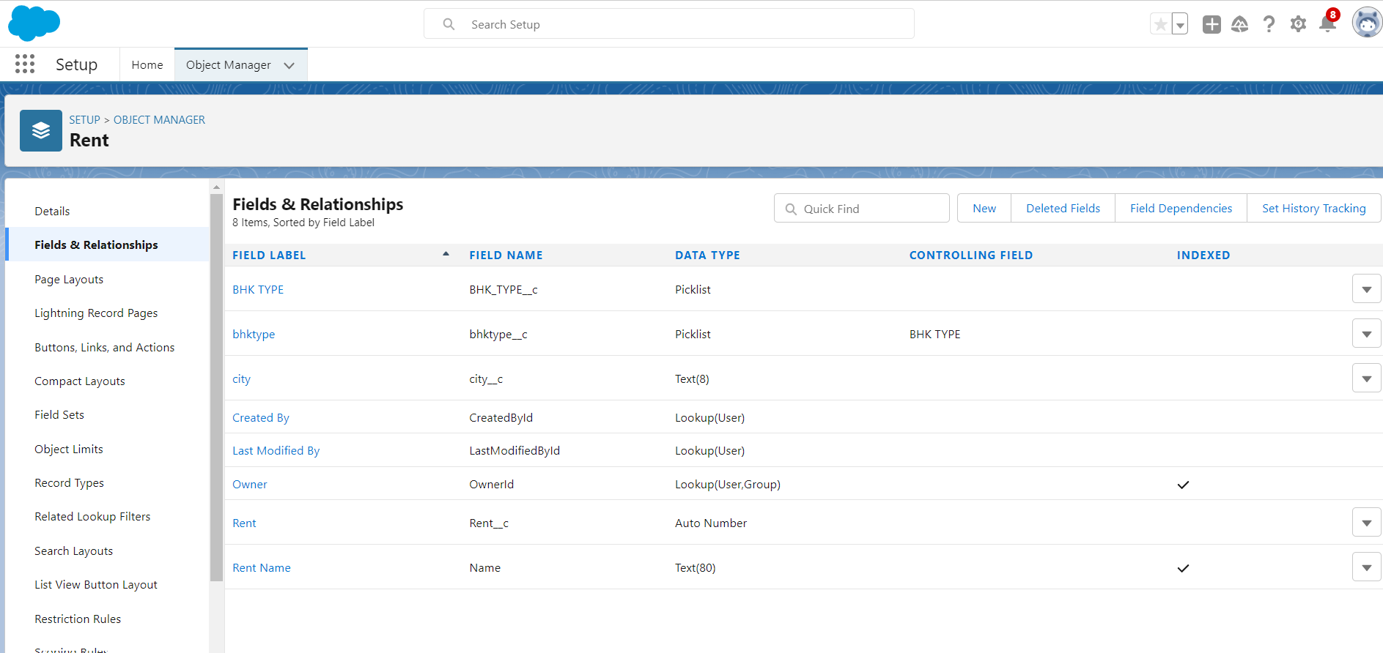
Activity 3: Create Field for Rent

Slide 20
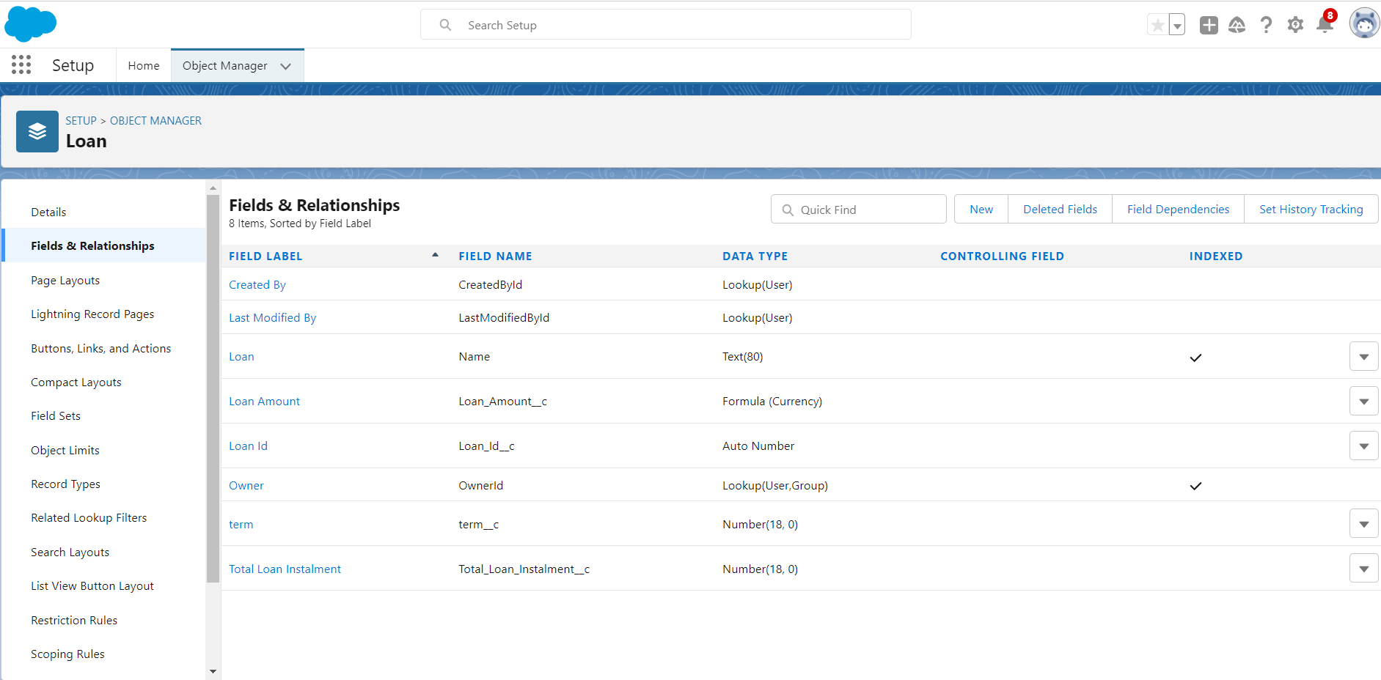
Activity 4: Create Field for Loan

Slide 21
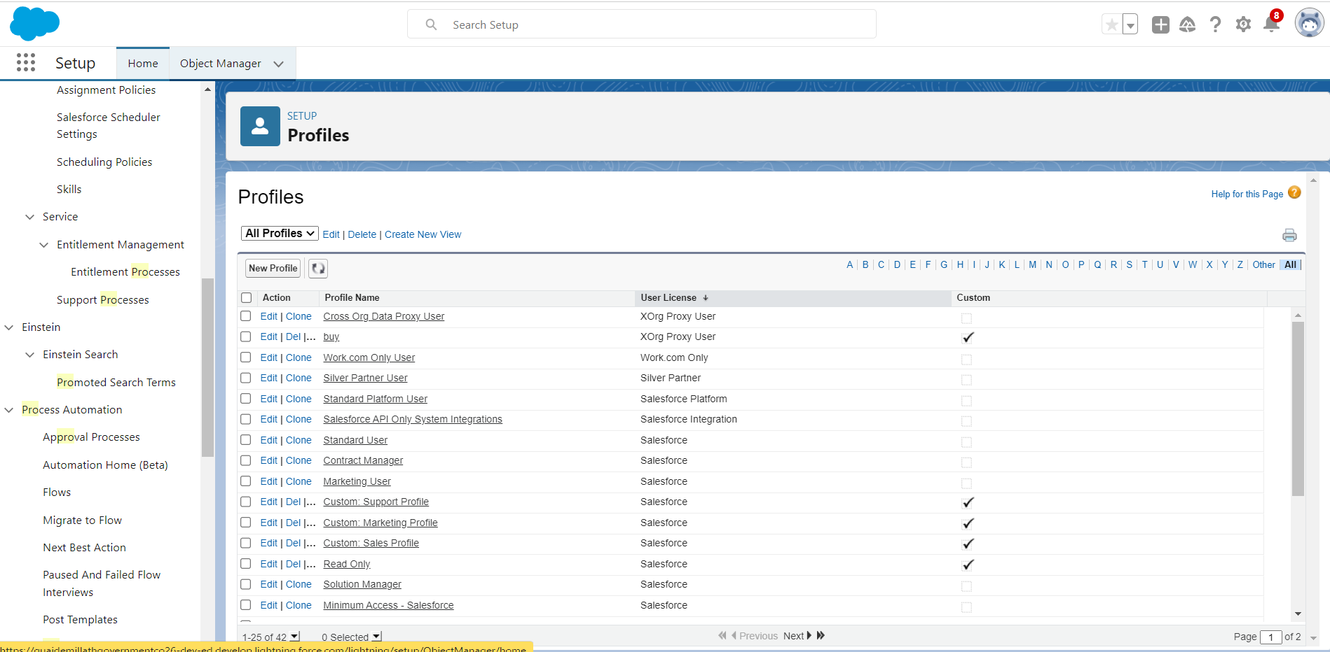
Activity2: For Object Buy

Slide 22
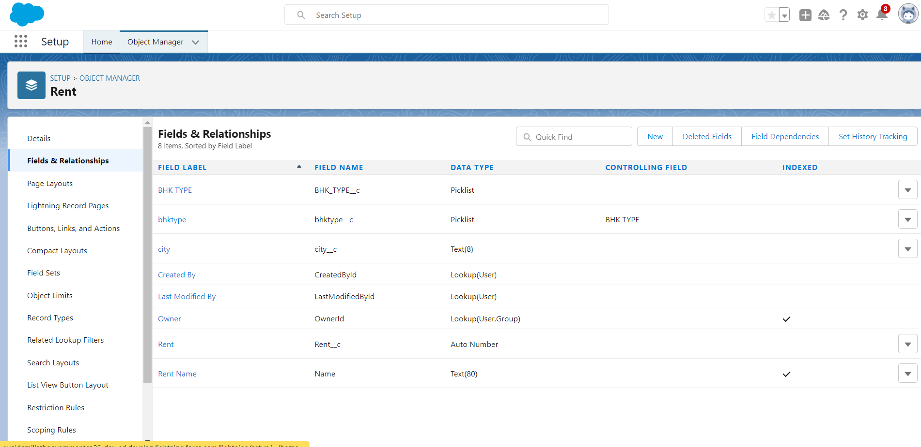
Activity3: Create Field for Rent

Slide 23
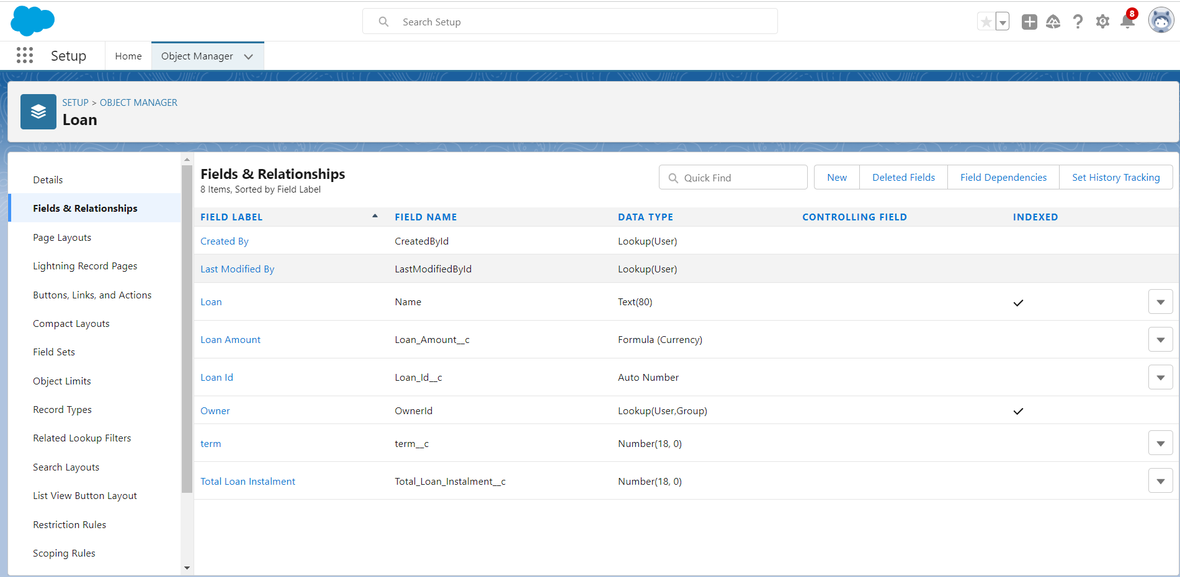
Activity4: Create Field for Loan

Slide 24
Milestone-6: Profile
A profile is a group/collection of settings and permissions that define what a user can do in salesforce.
You can define profiles by the user's job function. For example System Administrator,Developer, Sales Representative.

Slide 25
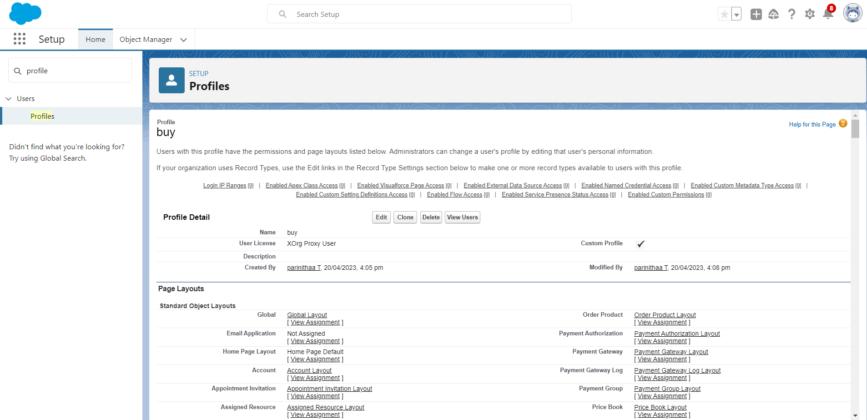
Activity 1: Create a New Profile

Slide 26
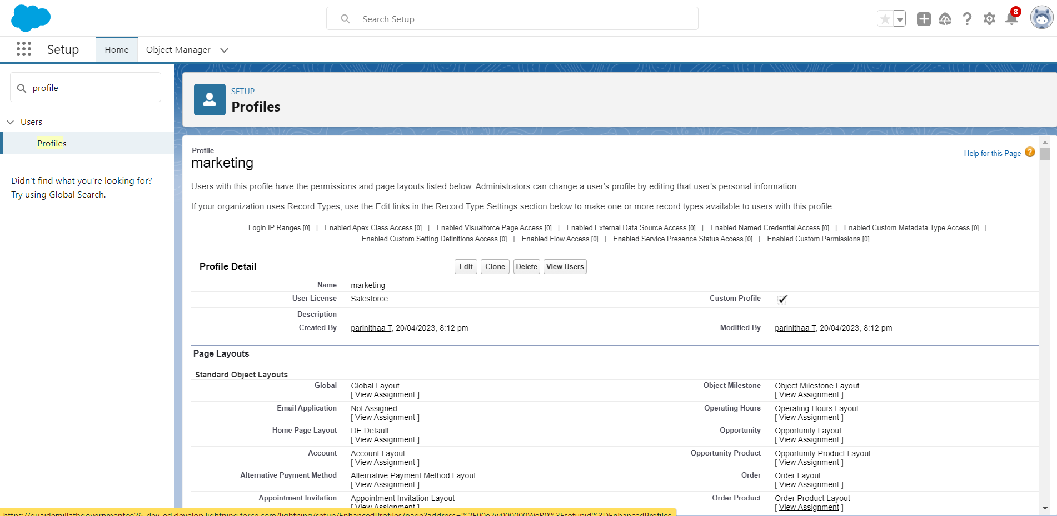
Activity 2: Create Marketing

Slide 27
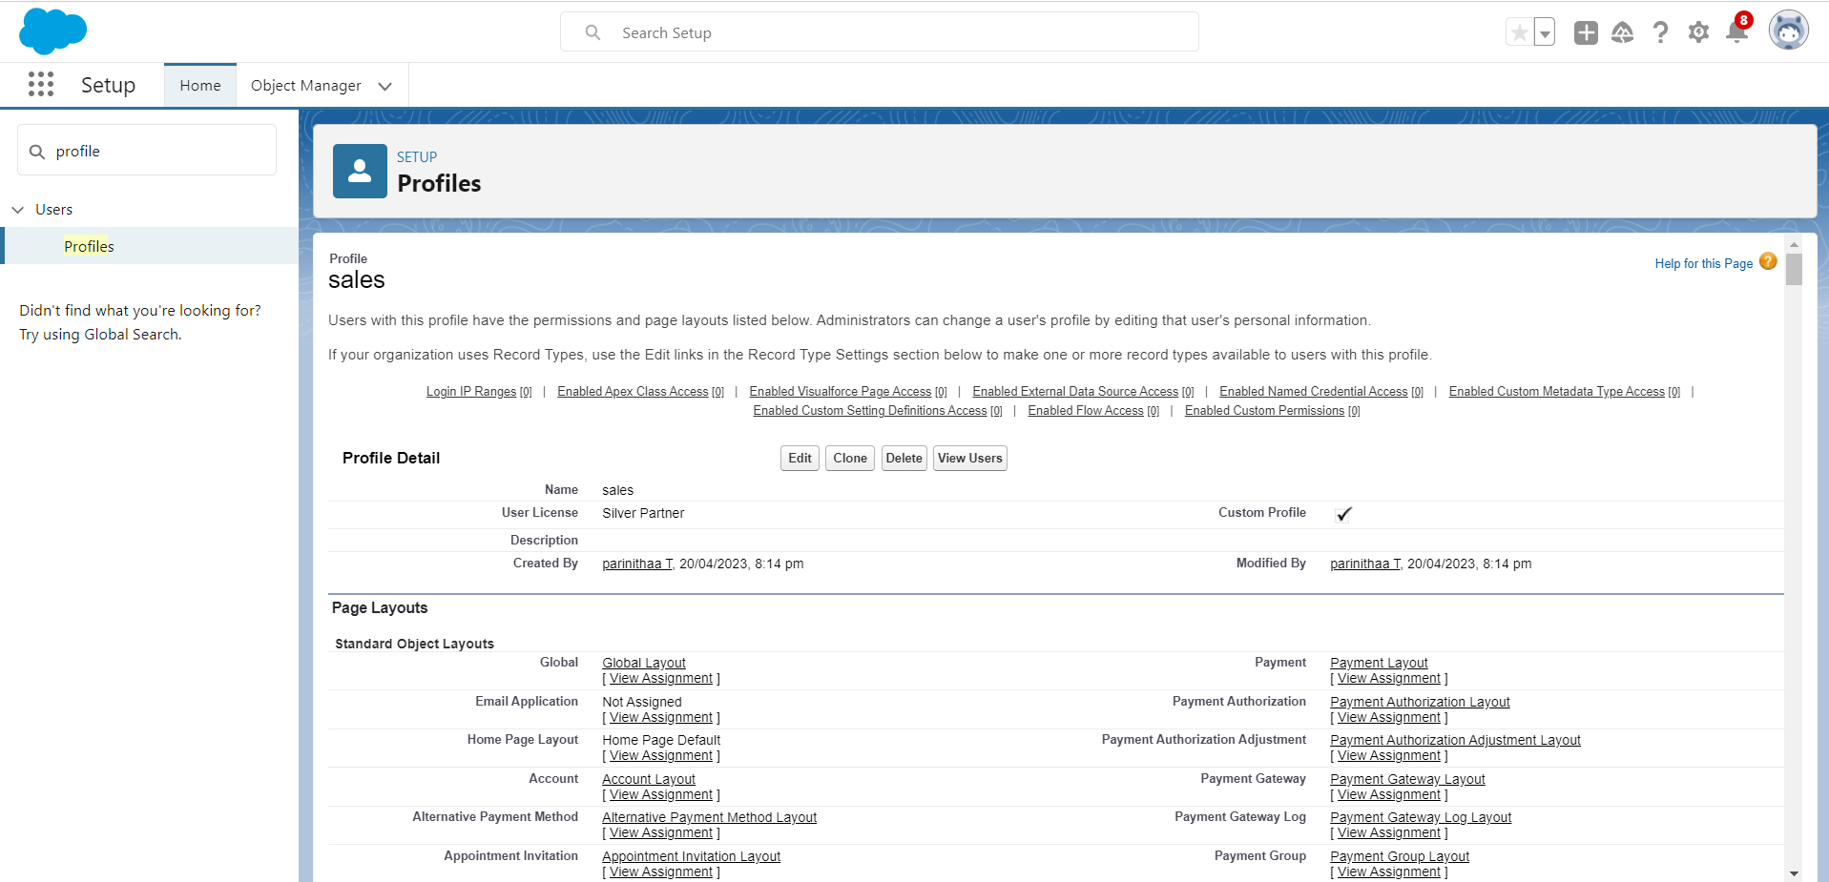
Activity 3: Create Sales

Slide 28
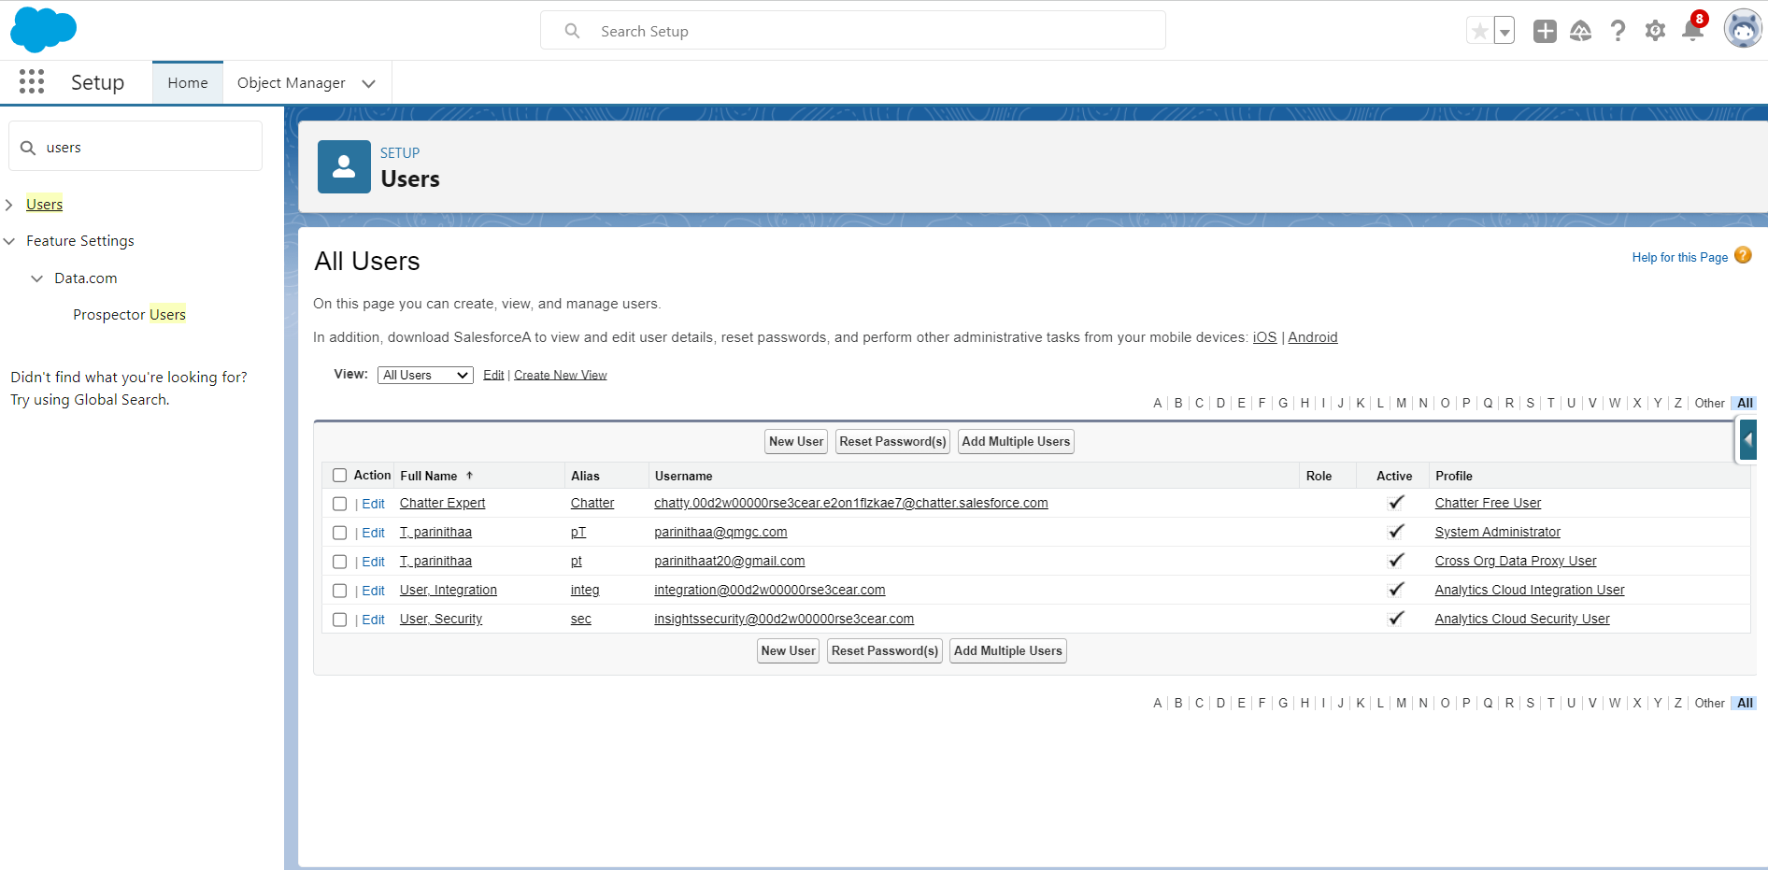
Milestone-7: New User
A user is anyone who logs in to Salesforce. Users are employees at your company, such as sales reps, managers, and IT specialists, who need access to the company's records.
Activity 1: Create User

Slide 29
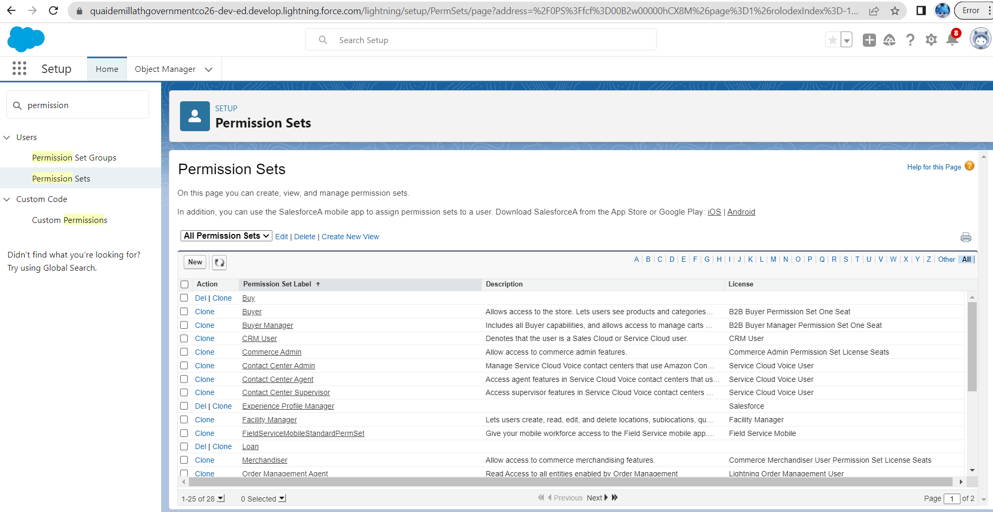
Milestone-8: Permission Set
A permission set is a collection of settings and permissions that give users access to various tools and functions. Permission sets extend users' functional access without changing their profile’s. Users can have only one profile but, depending on the Salesforce edition, they can have multiple permission sets.
Activity 1: Create a Permission Set

Slide 30
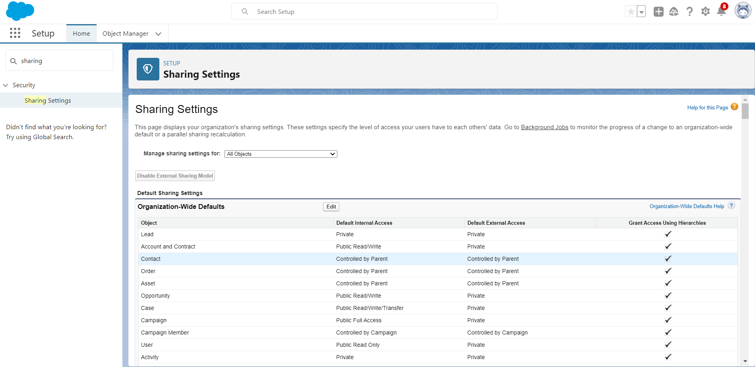
Milestone-9: Setup For OWD
Organization-Wide Defaults, or OWDs, are the pattern security rules that you can follow for your Salesforce instance. Organization Wide Defaults are utilized to confine who can access what information in your CRM.
Activity 1: Create a OWD Setting

Slide 31
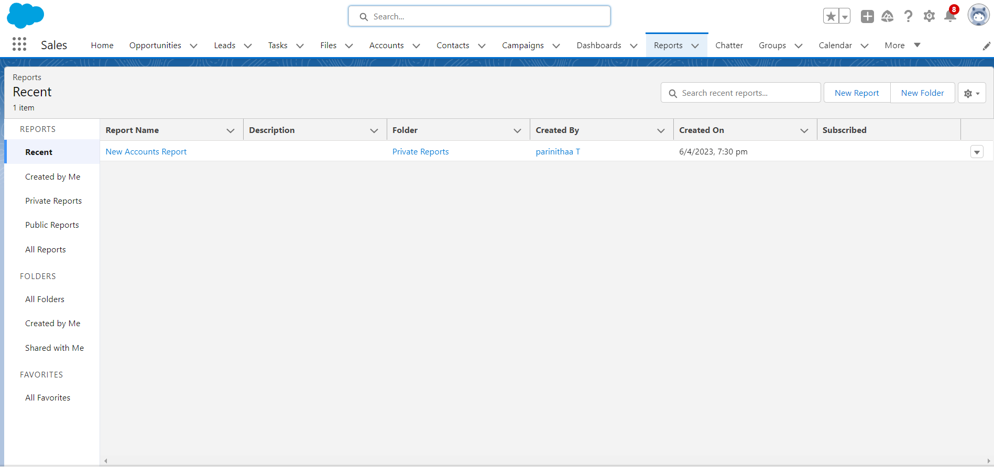
Milestone-10: Report
Reports give you access to your Salesforce data. You can examine your Salesforce data in almost infinite combinations, display it in easy-to-understand formats, and share the resulting insights with others. Before building, reading, and sharing reports, review these reporting basics.
Activity 1: Create Report

Slide 32
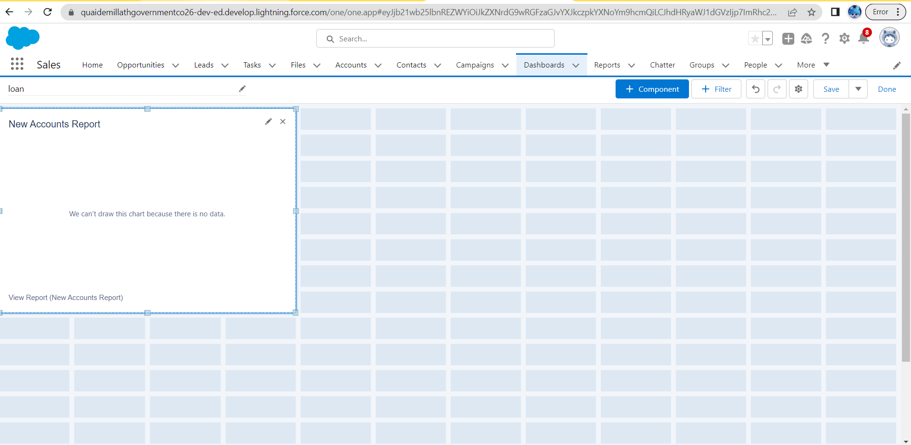
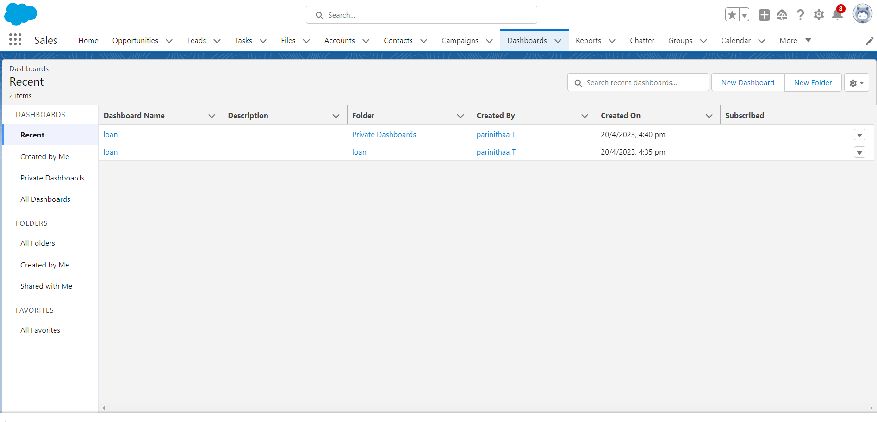
Milestone11: Dashboards
Dashboards help you visually understand changing business conditions so you can make decisions based on the real-time data you’ve gathered with reports. Use dashboards to help users identify trends, sort out quantities, and measure the impact of their activities. Before building, reading, and sharing dashboards, review these dashboard basics.
Activity 1: Create Dashboard

Slide 33
Trialhead Profile Public URL
TEAM LEADER | https://trailblazer.me/id/parinithaa
TEAM MEMBER 1 | https://trailblazer.me/id/nandhukutty03
TEAM MEMBER 2 | https://trailblazer.me/id/narma86
TEAM MEMBER 3 | https://trailblazer.me/id/priya1112

Slide 34
ADVANTAGES:
Ability to modify the system the way you get used to instead of adjusting your processes to the new system functionality and, consequently, increase user adoption rates.
Easy integration of all real estate management systems with Salesforce without the risk of disrupting the pre-built features.
Almost infinite scalability of the solution exactly when you need it.
Ability to make the system interface as user-friendly as possible to simplify the transfer to a new system. Especially, if you migrate from another CRM system that your users have got accustomed to.
Possibility to get your system issues resolved faster and get in-time support from your Salesforce consultant and developer.

Slide 35
DISADVANTAGES:
Lack of specialists that have a deep understanding of property management business and its priorities.
Higher price if you look not only for technical skills but for industry expertise, especially in specific niches like property management.
Need for continuous platform improvement and maintenance with each Salesforce release to ensure that all custom features work as it has been planned.
Creation of custom user training material and workshops.
Documentation of every important product customization milestone.

Slide 36
APPLICATIONS:
Lease agreement
A lease agreement is an arrangement, made between two parties, that allows one of those parties to use an asset belonging to the owner. Typically, lease agreements are used for rental properties, but they are also used for rentals of vehicles, household appliances, construction equipment, and other items.
Rent collection
The relationship of a landlord to their tenant is hard to explain. The Indian real estate market is currently beaming with prospective renters, but how many landlords are willing to take the risk? Surprisingly, the numbers are strikingly low.
Accounting service
Accounting is without a doubt a crucial part of any business's operations. Further, accounting services include tax preparation and counseling, as well as tracking spending and earnings.
Management Agreement
A management agreement is a legal contract between two parties, typically between an owner and a manager, that outlines the terms and conditions of the management services that will be provided.
Maintenances & Repair
Repair and maintenance are used hand-in-hand, but they refer to different things in the asset management space. Repairs are restoration work for when an asset breaks, gets damaged, or stops working.

Slide 37
CONCLUSION
Property Management Application Using Salesforce is a comprehensive tool with an exhausting list of benefits and, despite its seeming complexity that can overwhelm at first, can become the best friend for property manager’s. Each property management company can take advantage of the platform in its unique way due to its scalability and flexibility. And even if you don’t want to spend time tuning the standard functionality of Salesforce, you can leverage its advantages with pre-configured Salesforce solutions for property management. Once you are ready to welcome Salesforce into your real estate agency and simplify the process of its implementation, then our Salesforce consulting services will be the best fit for you.

Slide 38
FUTURE SCOPE:
Opportunity for exercising the faculties or abilities; capacity for action.
Range of view, perception, or grasp; outlook. 3 the area covered by an activity, topic, etc.; range.

Slide 39
THANK YOU

